Slide 1
Sentiment Analysis of Drug Review by online pharmaceutical review sites
Submitted by:
Akash K Shetty
Gautham S Nair
Saurabh P Nagvekar
Saurabh S Karpe
Shashank M Paralkar
Mentor: Anjana Agarwal

Slide 2
Problem Statement
As we know that Sentiment Analysis is playing a major role in Medical Domain. It has been shown that performing sentiment analysis on drug reviews is useful in many ways like when a new drug is released or used users or patients publish their opinions about the drug on the social Web. The sentiment analysis results of drug reviews will be useful not only for patients to decide which drugs they should buy or take, but also for drug makers and clinicians to obtain valuable summaries of public opinion and feedback.
The dataset provides patient reviews on specific drugs along with related conditions and a 10 star patient rating reflecting overall patient satisfaction. Therefore, We have to create a target feature out of ratings and predict the sentiment of the reviews.

Slide 3
DataSet: Features & Info
The dataset provides patient reviews on specific drugs along with related conditions and a 10star patient rating reflecting overall patient satisfaction. The data was obtained by crawling online pharmaceutical review sites.
Feature Name | Type | Description & Values | % Missing
Unique ID | Numerical | Unique ID of registration of each patient. | 0.00%
Drug Name | Categorical | The name of the drug used by the patient. | 0.00%
Condition | Categorical | The medical condition of the patient. | 0.55%
Review | Categorical | The review of the drug by the patient. (includes side effects, positive reviews, consequences after usage) | 0.00%
Rating | Numerical | The rating of each drug based on the usage by patients. Rating from 1 to 10 (1-lowest, 10-highest) | 0.00%
Date | Categorical | The date on which the patient has entered the review of the drug. | 0.00%
Useful Count | Numerical | The number of users who found the reviews posted to be useful. | 0.00%

Slide 4
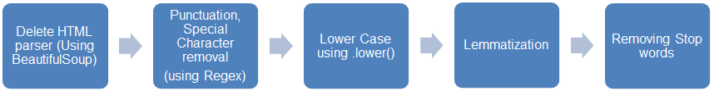
Suggested Solutions to the problem
⮚The training dataset with approximately 160K records requires text-cleaning before Model building.
⮚The pre-processing/ cleaning text follows certain steps such as removal of punctuations like “,”, “!” and “.” , special characters like ‘â’ , stop words like a, an, the etc. Below operations are performed to handle these exceptions:

Slide 5
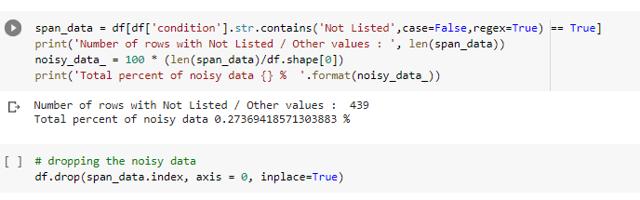
Exploratory Data Analysis
Removed rows from condition column which consists Not listed/ Other

Slide 6
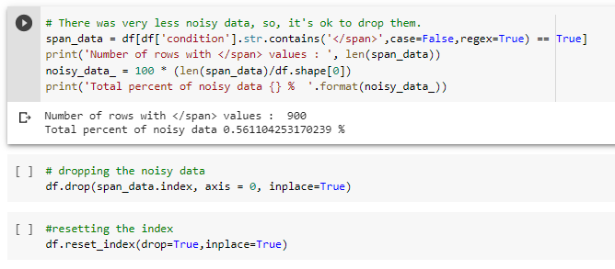
Exploratory Data Analysis
Removed rows from condition column which consists </span>

Slide 7
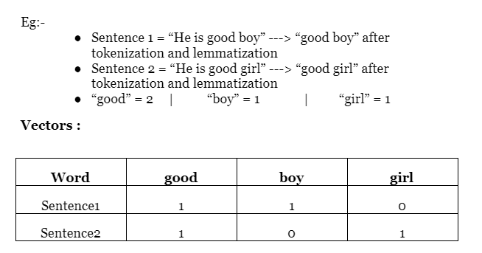
Bag of Words Methods
CountVectorizer: CountVectorizer model is used to preprocess the text by converting it into a bag of words, which keeps a count of the total occurrences of most frequently used words.
This model can be visualized using a table, which contains the count of words corresponding to the word itself.

Slide 8
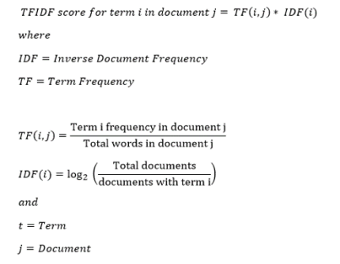
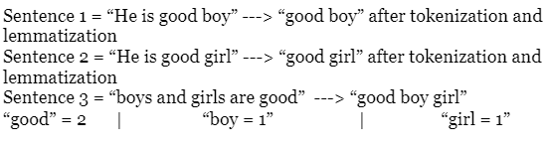
Bag of Words Methods
2. Tf-idf : TF-IDF or (Term Frequency-Inverse Document Frequency(IDF) ) is a technique which is used to find meaning of sentences consisting of words and cancels out the incapabilities of Bag of Words technique which is good for text classification or for helping a machine read words in numbers.
Example:
Cont…..

Slide 9
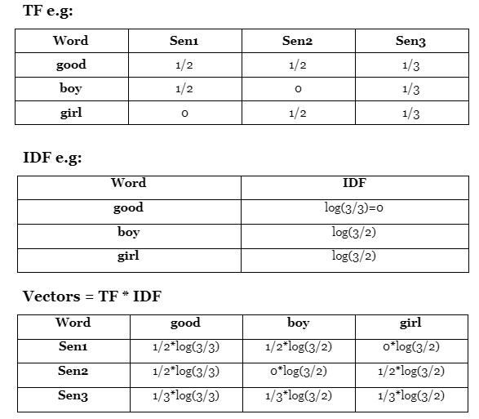
Bag of Words Methods
2. Tf-idf :

Slide 10
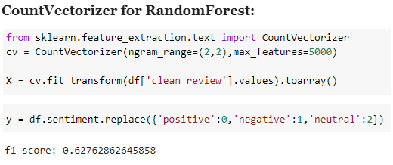
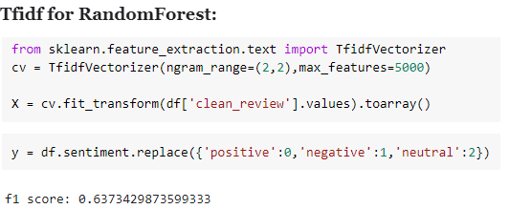
Bag of Words Methods
We got F1 score comparatively high in Tfidf in our base model.
In TF-IDFVectorizer we consider overall document weightage of a word. It helps us in dealing with most frequent words. Using it we can penalize them.

Slide 11
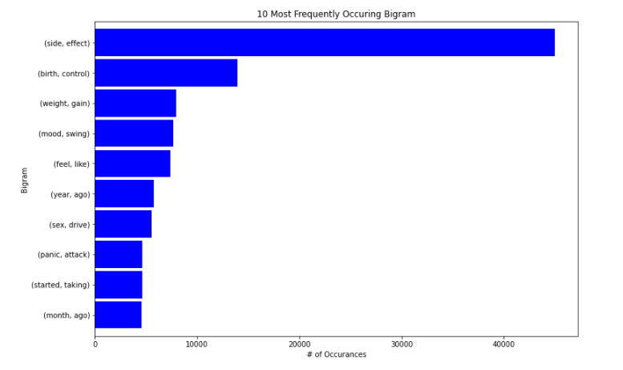
Exploratory Data Analysis
10 Top most bigram occurring frequently

Slide 12
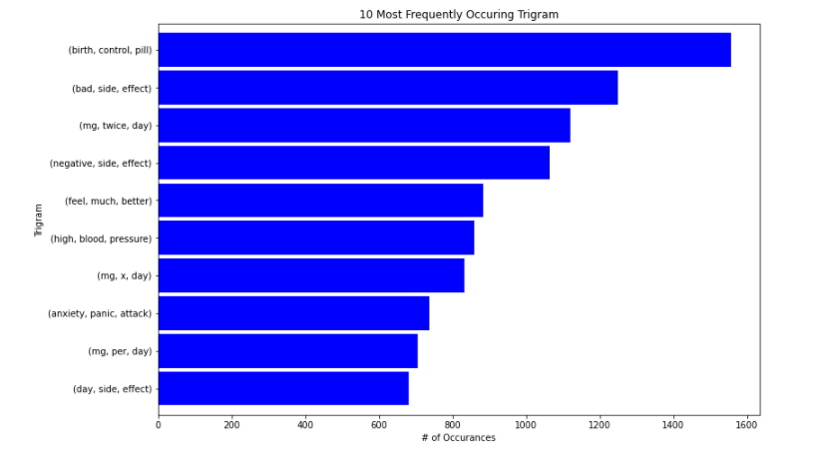
Exploratory Data Analysis
10 Top most trigram occurring frequently

Slide 13
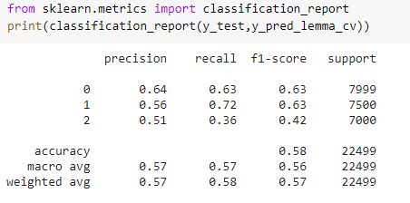
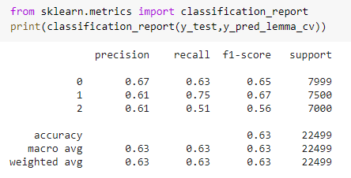


Base Model with 3 classes
Multinomial NB:
RandomForest:

Slide 14
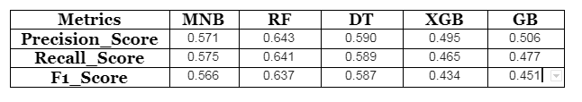
Model Metrics with 3 classes
As we can see RandomForest is having a better F1 score compared to other models.
After fitting the model using 3 Classes we saw that there is a bias in one of the classes as in the previous slide where the recall score in base model is having a huge difference with other 2 classes.
Therefore we tried to proceed with 2 classes for better accuracy.

Slide 15
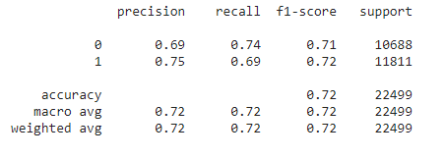
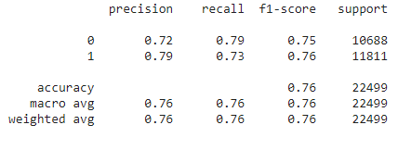


Base Model with 2 classes
LogisticRegression:
RandomForest:

Slide 16
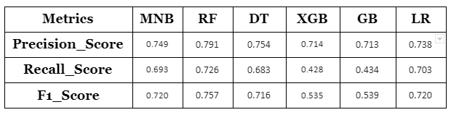
Model Metrics with 2 classes
As we can see RandomForest is having a better F1 score compared to other models.
After fitting the model using 2 Classes we are seeing a better balance between 2 classes unlike 3 classes
Therefore we came to the conclusion to proceed with 2 classes for better accuracy.

Slide 17
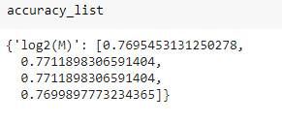
Hyperparameter Tuning
n_estimators is one of the most important hyperparameters for the extreme bagging model. n_estimators is the number of trees to be used in the forest. Since RandomForest is an ensemble method comprising of creating multiple decision trees, this parameter is used to control the number of trees to be used in the process.
Since Random Forest Classifier gave us the better F1_score. Thus choosing the best hyperparameters using Grid- Search CV. The main hyperparameters considered are : n_estimators, max_features
For n_estimators: 400,500,600,700
For max_features: We considered ‘log2’ as it is giving a highere accuracy compared to ‘sqrt’ and 2*‘sqrt’

Slide 18
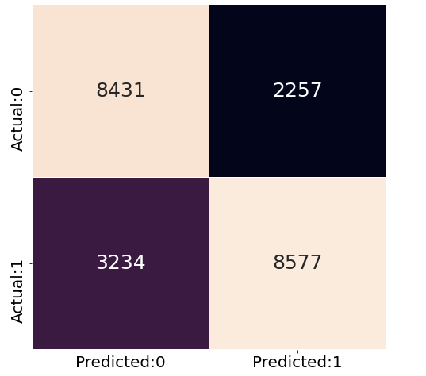
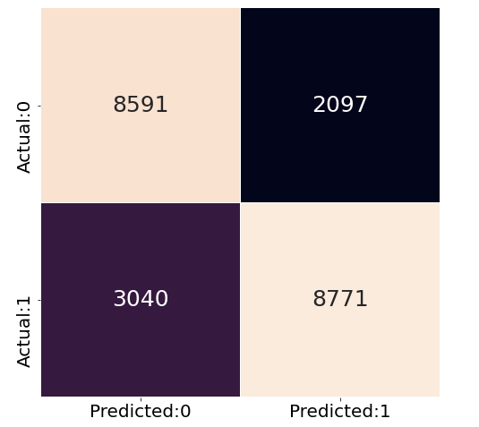


Tuned Model’s performance
Base Model
Tuned Model

Slide 19
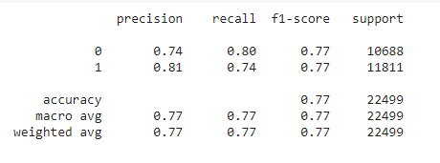
Classification Report of Test Data
•After applying the model on the test set the obtained results were:
•The above results are for model predicted sentiment vs patients sentiment.

Slide 20
Conclusion
Predicting the sentiments in review and ratings for the Sentiment Analysis of Drug Review by Patients which formed different classification models such as Logistical Regression, Decision Tree, Random Forest, Ada Boost, XGB Classifier, Gradient Boosting, Multinomial Naïve Bayes, f-1 scores for all the models are taken and compared.
After comparing all the models, RandomForest Classifier gave the best result in terms of F1_score. The scoring for RandomForest Classifier is then improved with the help of hyperparamter tuning.
A significant improvement was observed after hyperparameter tuning for the RandomForest Classifier Model in order to detect and predict sentiments of the patients. Different n_estimator values were checked. The optimal n_estimator value is 600 which gave the weighted recall and F-1 score as 74% and 77% respectively.

Slide 21
Business Recommendation
The objective is: “Sentiment Analysis of Drug Review by Patients”. Thus, it is inferred that False Negatives (FN) are much costlier than the False Positives (FP). FP only costs a message that is sent to the user whereas FN affects the Drug maker, clinician and patient as directly affecting the ratings.
Based on the patients reviews and ratings, positive and negative sentiments will help drug industry/drug maker to analyses the drugs having best result for specific conditions.

Slide 22
THANK YOU

